Slide 1

British values

Slide 2
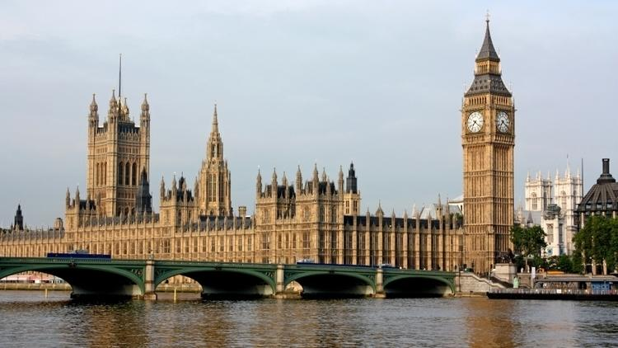
What are British values?
Democracy
The rule of law
Tolerance
Individual liberty
Mutual respect

Slide 3
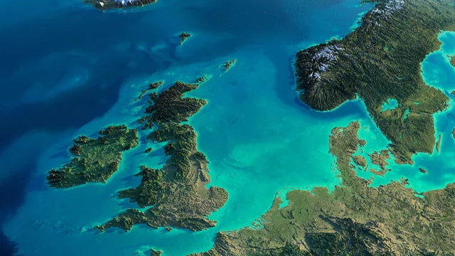
So what do these mean?

Slide 4

Democracy
Democracy is where everybody has a say in what goes on in an organization
A good example of a democracy Is a general election. Everyone above the age of 18 in the UK has the right to vote which means they have a say in who is elected.
At St Nicholas Primary School we vote for who represents us on the School Council. Our School Council Members meet regularly with the Headteacher discussing school decisions. We also know that we are entitled to have our say on issues that matter to us. Our teachers encourage us to take part and they listen to our views and ideas.
IDEA: Pupil Voice box – to allow suggestions – recognition slip thank you for your valued – post box attached to a wall on the playground

Slide 5
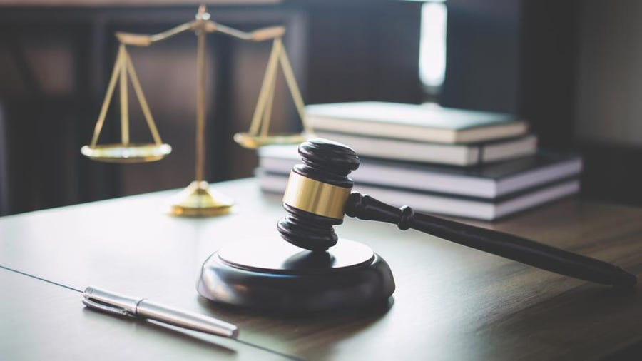
Rule of law
These are a set of rules we have to abide by
Laws are set by the government and apply to the whole country
If you do not follow the law, there will be consequences such as fines to pay or time to serve in jail
At St Nicholas Primary School we have our School Rules to ensure that everyone feels ready, respected and safe. Our behaviour policy uses levels of behaviour to support children understand consequences when rules are broken.

Slide 6

Individual liberty
Another term used is freedom
Most commonly found when we talk about freedom of speech and freedom of choice
How do we show this at St Nicholas?
At St Nicholas Primary School we are encouraged to make our own choices. We try to make wise decisions and do what’s right. Year 6 children are encouraged to apply and stand for jobs such as Eco Warrior. Our PSHE programme including our Jigsaw Charter embodies freedom of speech and choice within our PHSE lessons.
Teachers encourage courageous advocacy in children, including supporting various fundraising and worship activities. We strive to be the voice for the voiceless.

Slide 7
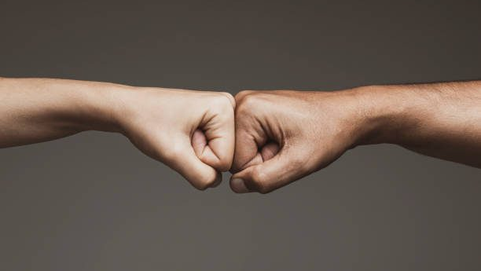
Mutual respect
This is the idea that we much respect one-another regardless of our differences
Listen and appreciate what someone else has to say
Be kind and supportive
At St Nicholas Primary School our vision, ‘Let all that you do be done with love’ encourages to consider and respect each other. Our ‘School Rules’ helps us to understand that we might not always agree with other people but we show respect for their thoughts and feelings. By doing this we can expect others to treat us the same way. We also explore the Christian Values of friendship, peace, forgiveness, perseverance, truth and thankfulness each year.

Slide 8

Tolerance
We accept and respect everyone’s differences, religion, belief’s, faiths
what someone believes does not change the way in which we treat them
How do we show this in St Nicholas?
At St Nicholas Primary School we enjoy learning about different faiths and cultures from around the world in our RE lessons. We welcome visitors to our school and learn from each other. Worldly day and spiritual day. Mental Health Day anti bullying. History curriculum learning about the past.

