Slide 1
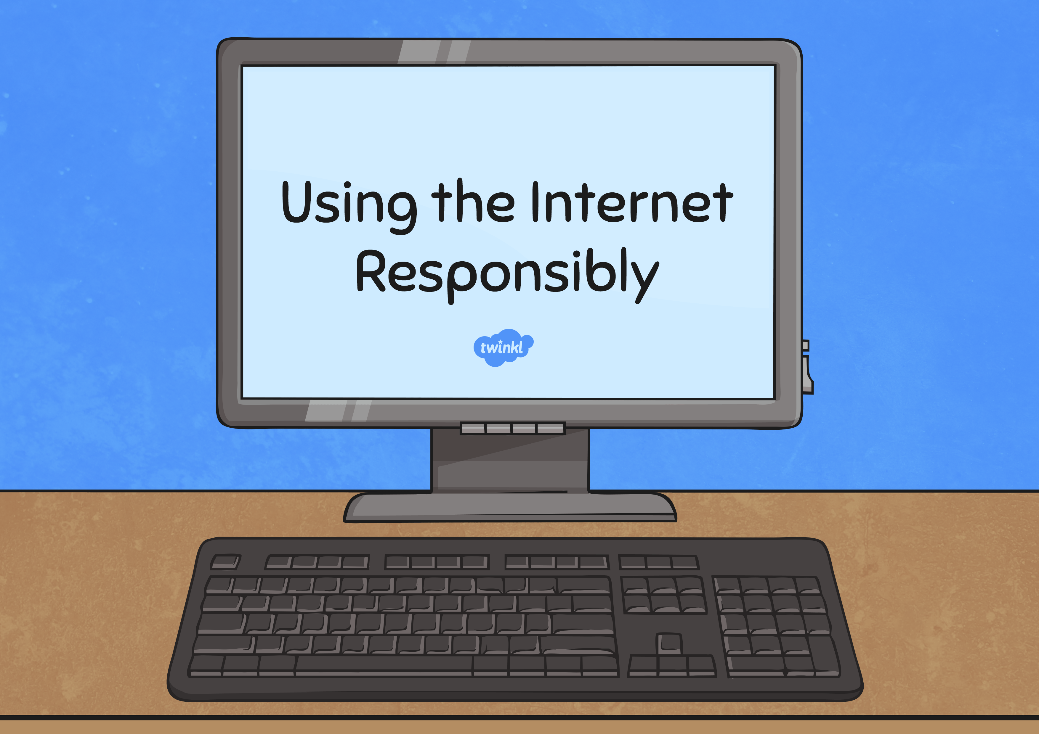
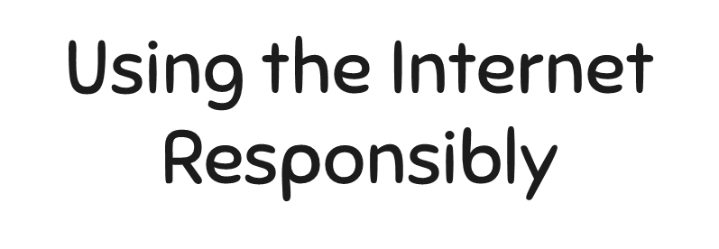


Slide 2
Digital Communication
Tools / Websites
Ways the Communication
Tools are Used

Slide 3
Match the definition to the correct hazard.
A message trying to sell you products or persuade you to visit their website.
People logging onto a site pretending to be you.
People sending unkind or nasty messages.
A nasty program that can damage your computer and files on it.
Cyber-Bullying
Virus
Spam
Identity Fraud

Slide 4
Sort the statements below to compare online and offline conversations.
Face to Face Conversations
Internet Conversations
Both
You can tell how old someone is.
You can't tell if someone is
being serious or joking.
You know who you are talking to because you can see them.
The person you are
talking to may be lying.
You don't know who you are talking to because you cant see them.
It's easy to tell what people
mean because you can hear the
tone of their voice.
You can pretend to be
older than you are.

