Slide 1
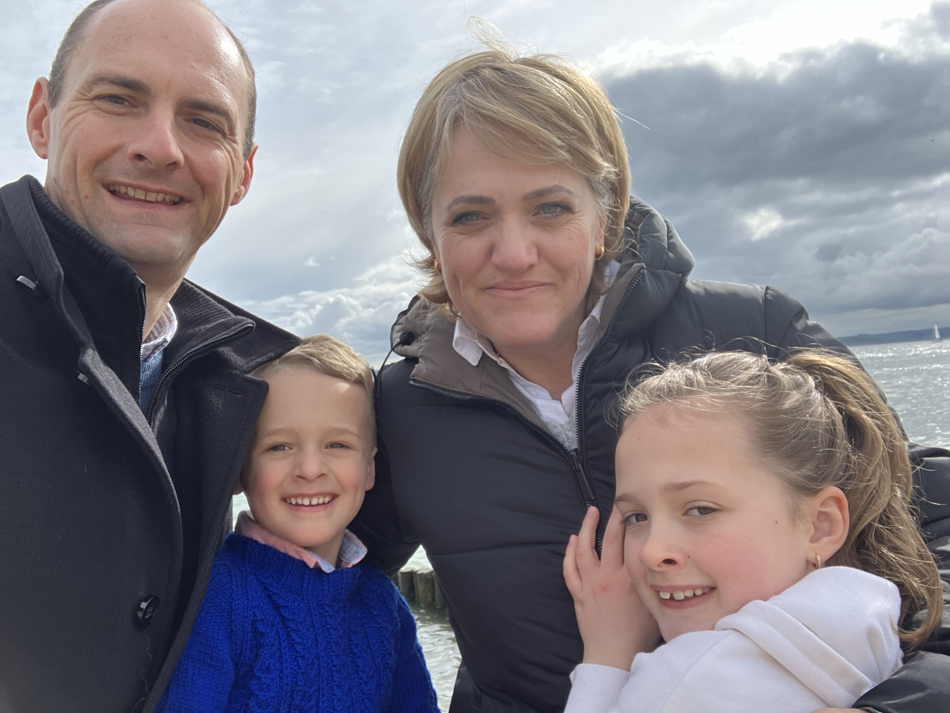

My family's trip to Sierra Leone

Slide 2

In July we are going away for a year to be crew on a hospital ship called the Global Mercy

Slide 3
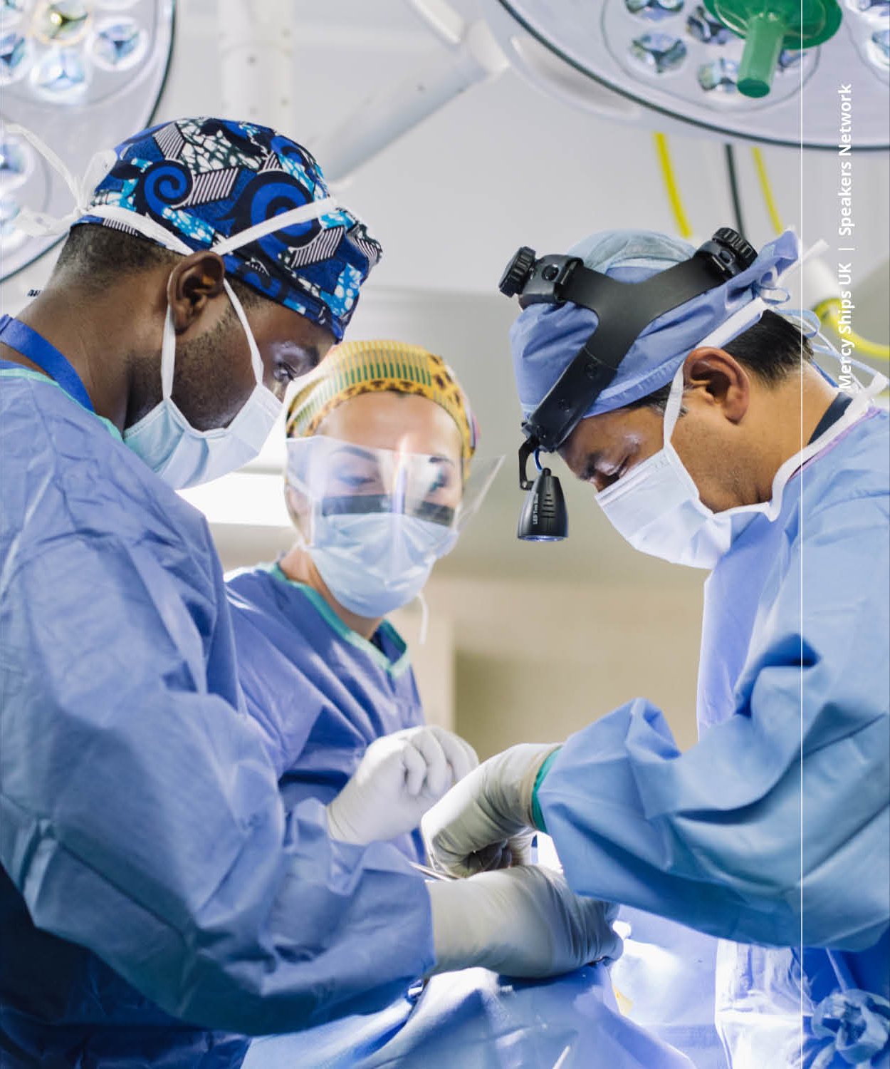
What does the ship do?
It goes countries where people can't afford to have an operation or there are not enough hospitals
We will show you a short video about Mercy Ships Who Is Mercy Ships? - 2024 Overview (vimeo.com)

Slide 4
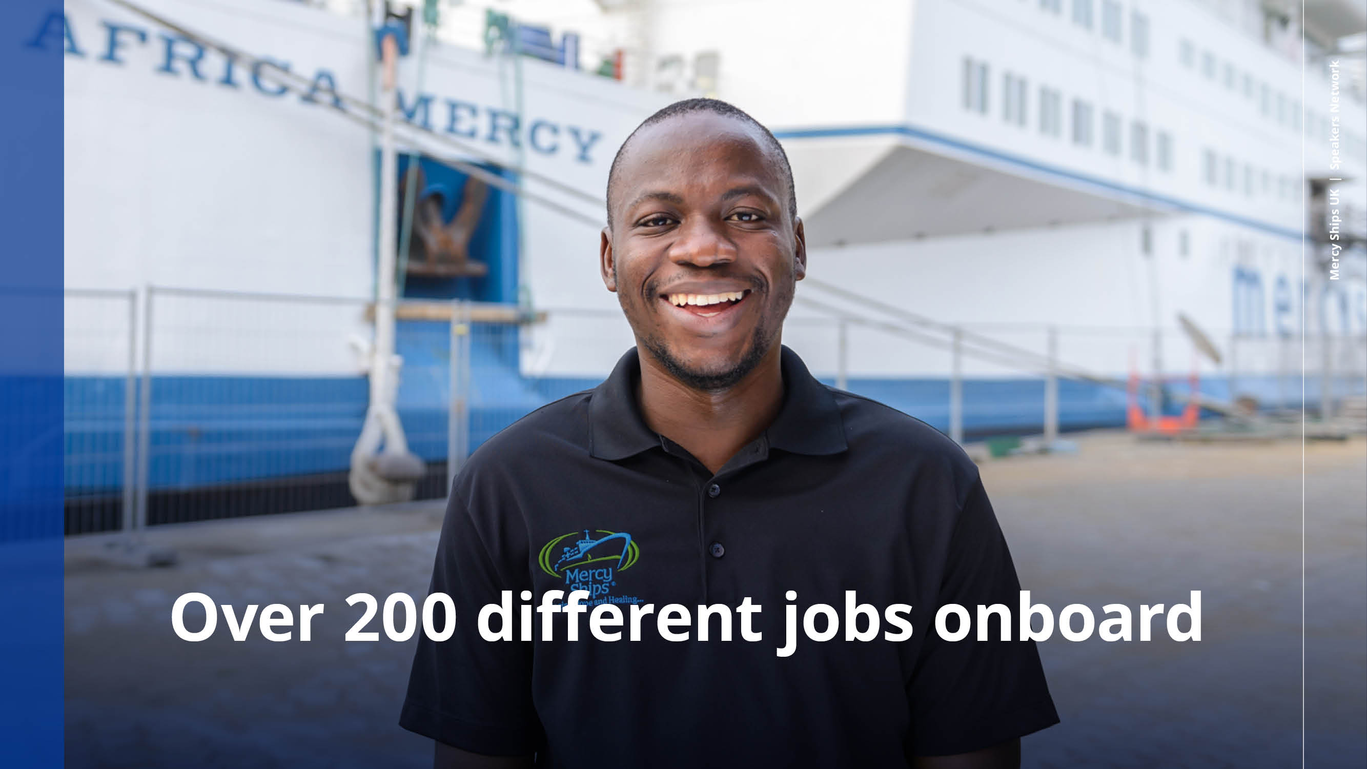
Notes:
We need volunteers from all walks of life. There are over 200 unique job roles available across different sectors

Slide 5
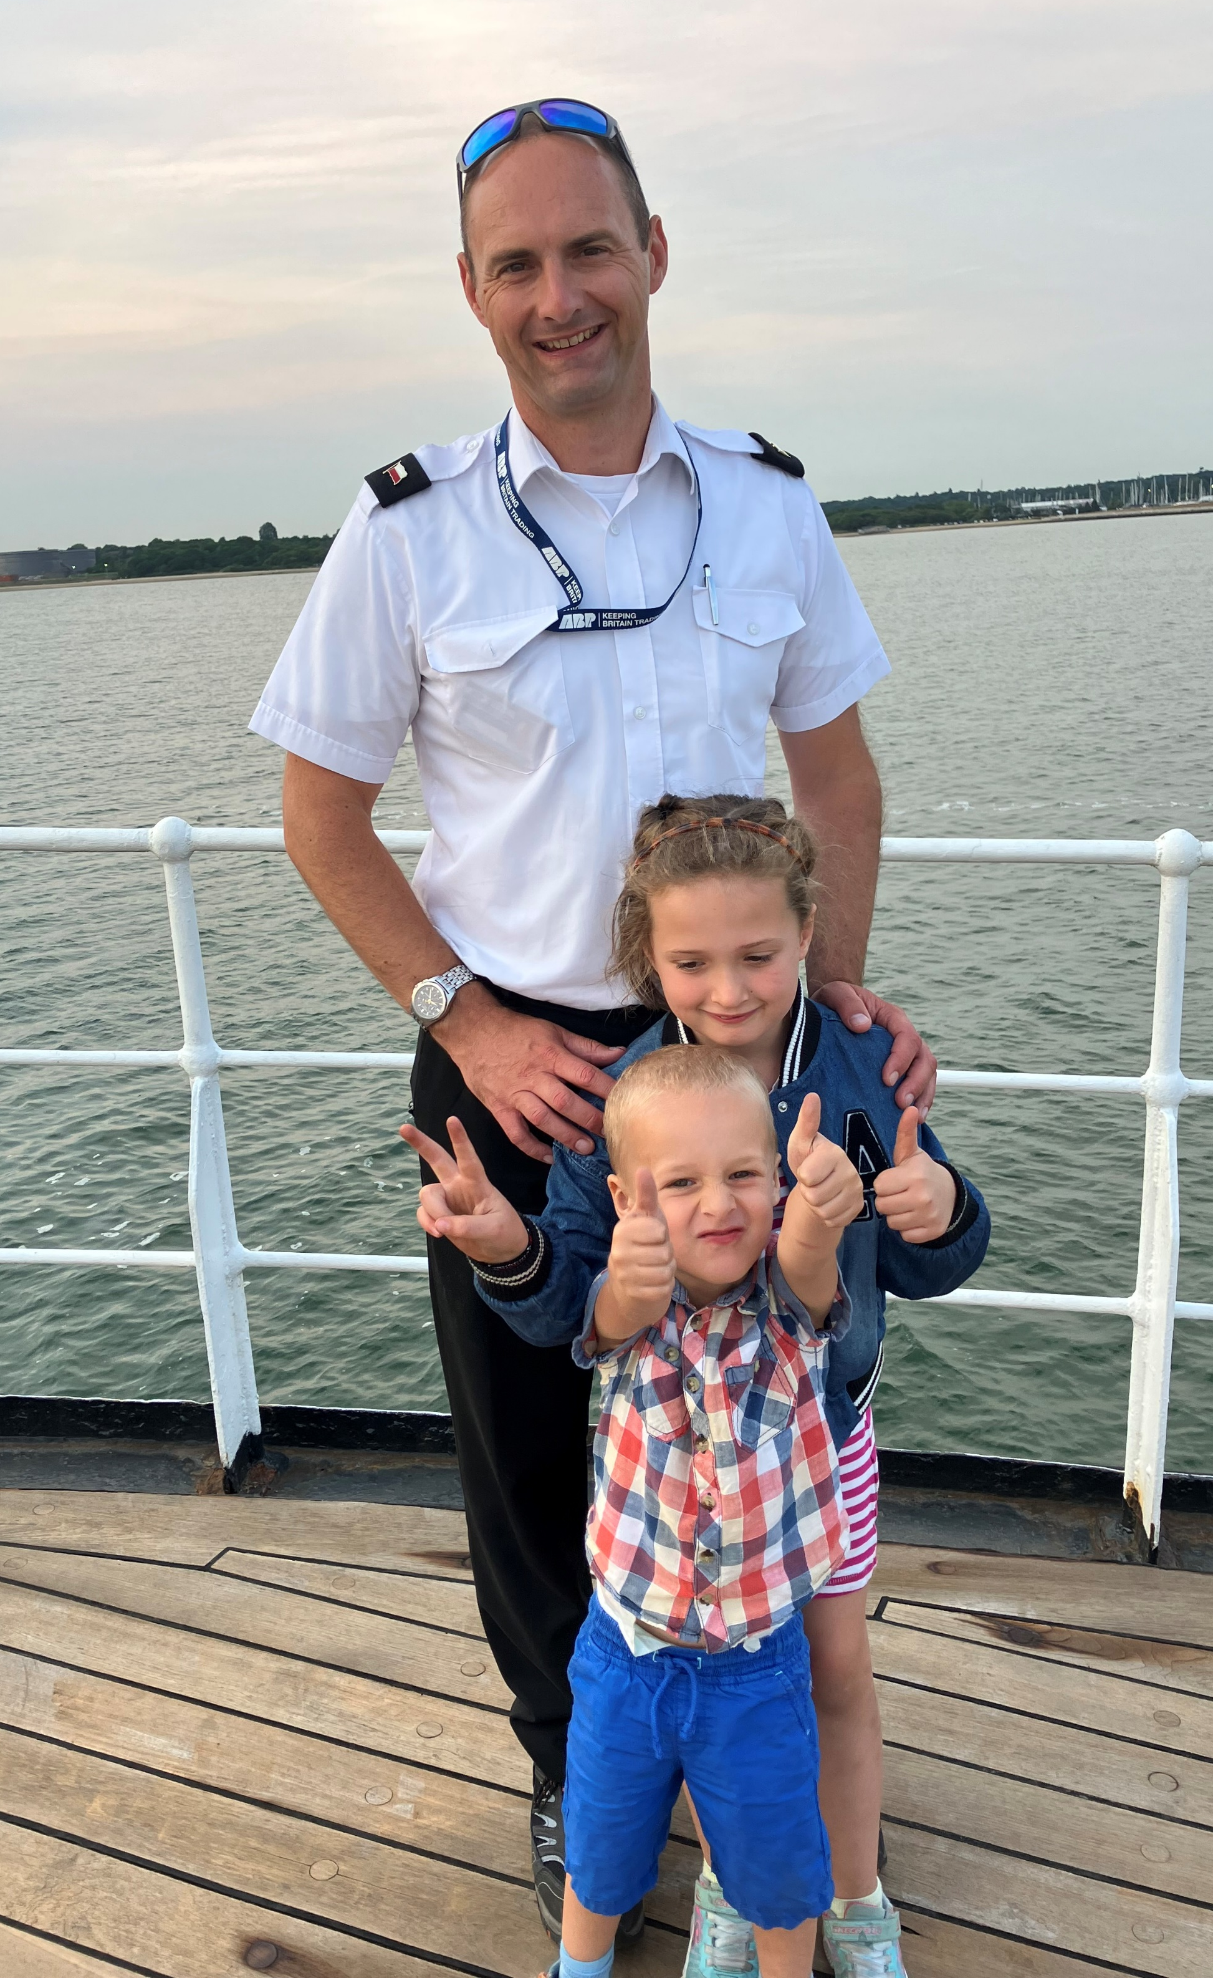
What will we be doing?
My Dad is going to be Chief Officer
My Mum is going to help the onboard community & work with people who are recovering from their operations
My brother and I will go to school on board at the Mercy Ships Academy
We will also have time to work and travel in Africa, exploring the countries we visit

Slide 6
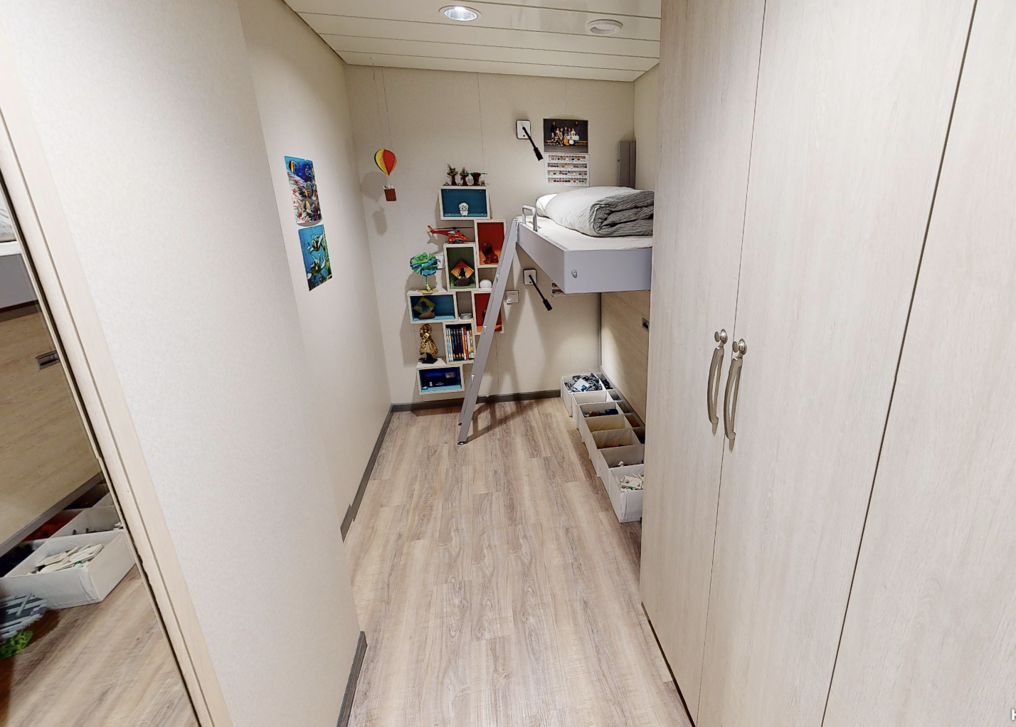
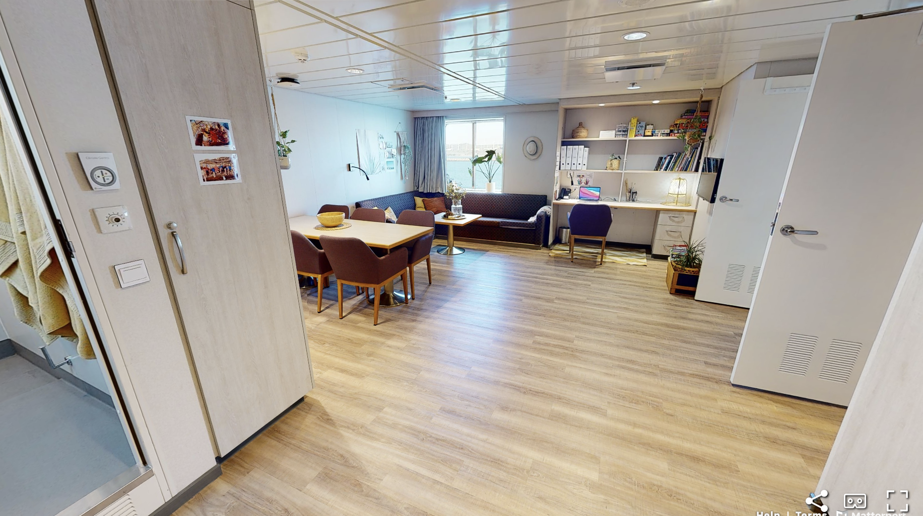
What is life like on board?
We will live in a family cabin…
My bedroom will look like this…

Slide 7
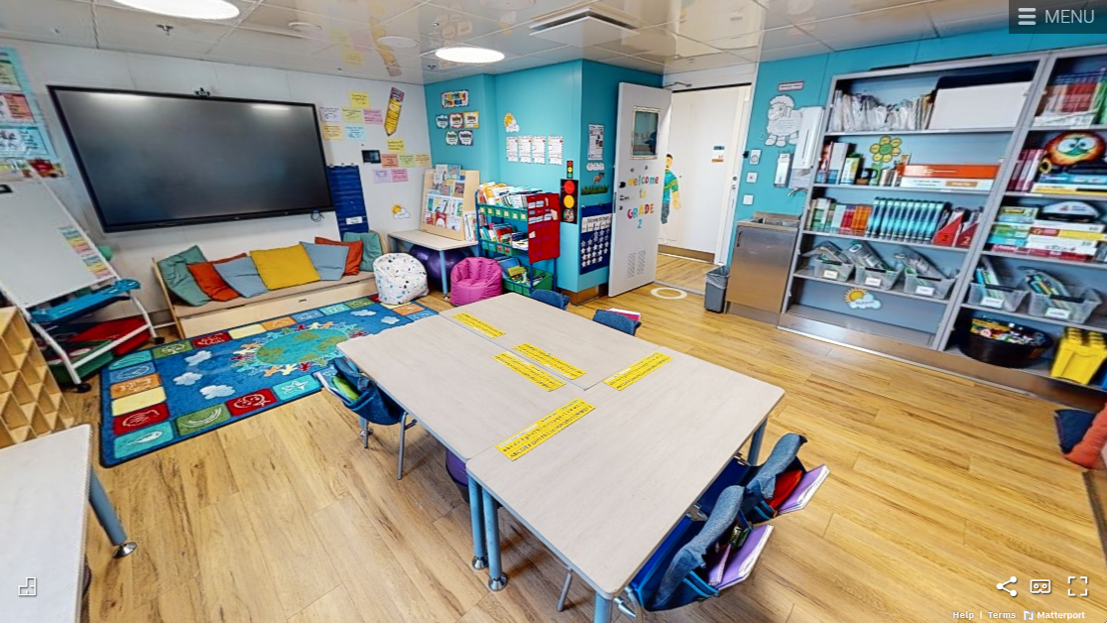
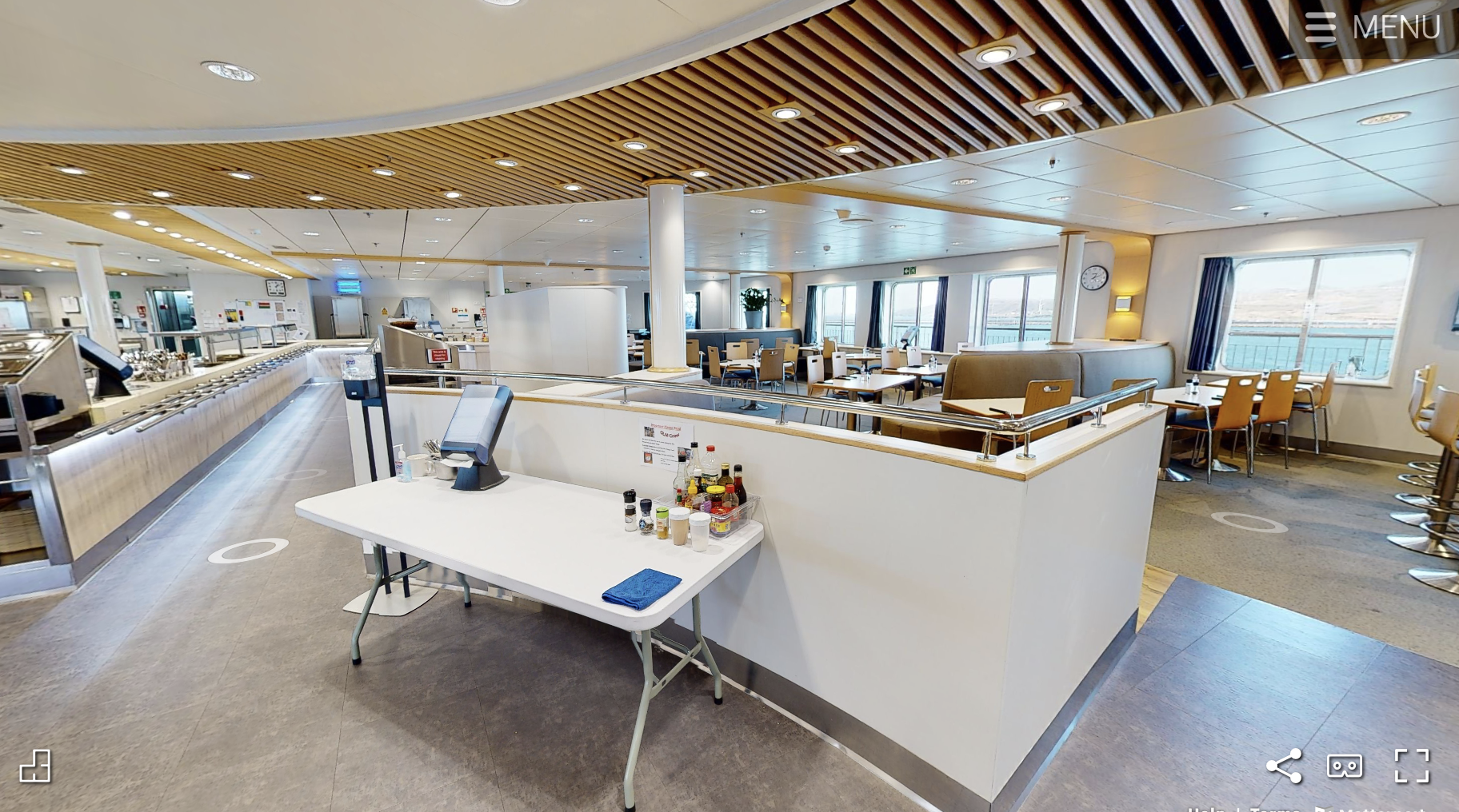
What is life like on board?
We will eat in the mess room with the other volunteers – they come from 60 different countries!
I will be in grade 2 – this will be my classroom…

Slide 8
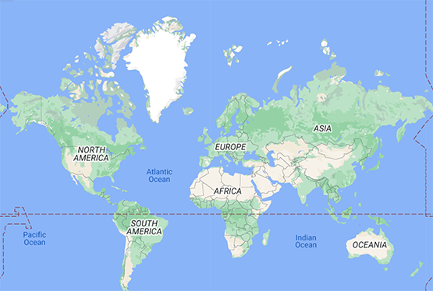
Our travel through the Atlantic
First we fly to Texas for training
Next we fly to Tenerife to join the ship in the shipyard
Last of all the traveling the ship will sail across the Atlantic to Freetown in Sierra Leone

Slide 9
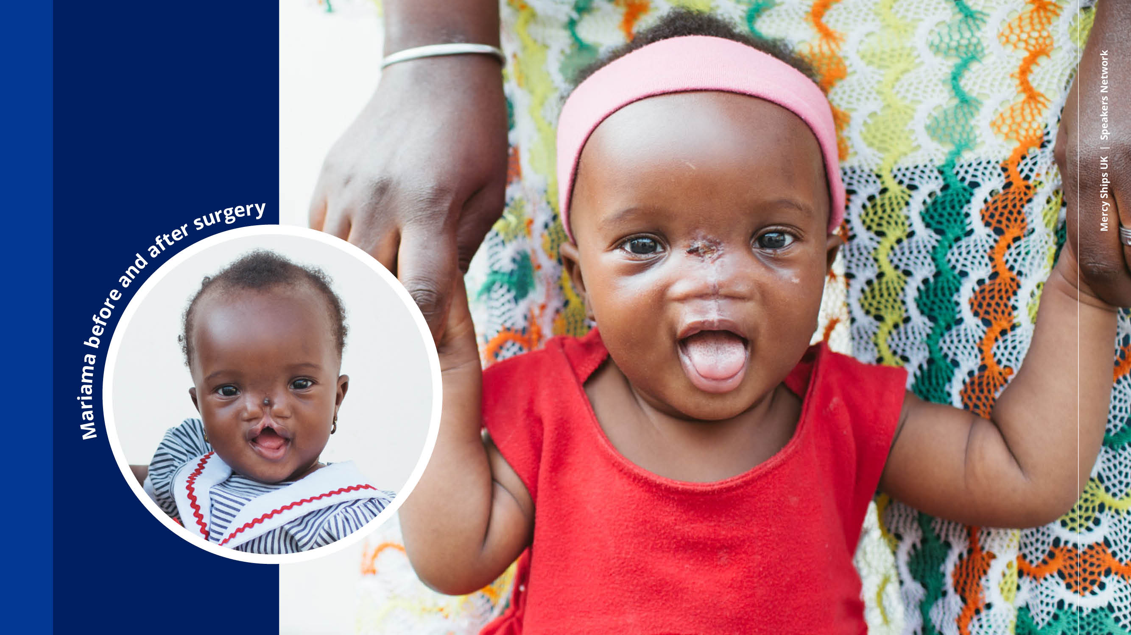
Here are some pictures of people that have had surgery on Mercy Ships…
Notes:
After her surgery, Mariama and her family stayed at the HOPE (Hospital Out Patient Extension) centre where her parents learned how to make nutritional baby formula and learned about the importance of continued nutrition for their child.

Slide 10
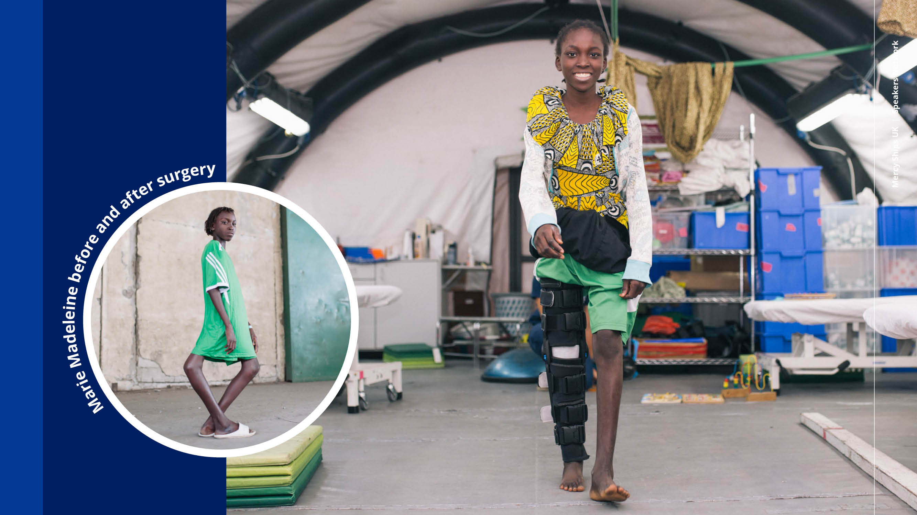
Notes:
One day, a miracle arrived in the form of news from a neighbour in their village, who told them about the Africa Mercy arriving in the Port of Dakar, about 100 miles from their home. The neighbour gave Marie's grandmother the information for the patient selection process, and soon Marie Madeleine had a surgery scheduled.
Several months after her arrival at the Africa Mercy, the bright 13-year-old girl with the triumphant smile and straight legs was ready to go home and back to school!

Slide 11

Notes:
If you feel you or someone you know can make a difference, take a leaflet, or come and speak to me after for more information. I can provide you with all the information you need.
Thank you again for your time.

